Slide 1
Problem Solving – Basic Search methods
Lecture Module 3
Prof Saroj Kaushik

Slide 2
Problem Characteristics
Heuristic search is a very general method applicable to a large class of problem.
In order to choose the most appropriate method (or combination of methods) for a particular problem it is necessary to analyze the problem along several key dimensions.
  Is the problem decomposable into a set of independent smaller sub problems?
Prof Saroj Kaushik

Slide 3
Contd..
  Decomposable problems can be solved by the divide-and-conquer technique.
    Each sub-problem is simpler to solve.
    Each sub-problem can be handed over to a different processor. Thus can be solved in parallel processing environment.
  Is problem non decomposable? Need different strategies
    For example, Block world problem is non decomposable.
Prof Saroj Kaushik

Slide 4
Initial State (State0) Goal State
Start: ON(C, A) ….
Goal: ON(B, C) Λ ON(A, B)
A
B
C
C
A
B
Prof Saroj Kaushik

Slide 5
Contd..
Can solution steps be ignored or at least undone if they prove to be unwise?
  In real life, there are three types of problems:
    Ignorable,
    Recoverable and
    Irrecoverable.
Prof Saroj Kaushik

Slide 6
Example - Ignorable
(Ignorable): In theorem proving - (solution steps can be ignored)
  Suppose we have proved some lemma in order to prove a theorem and eventually realized that lemma is no help at all, then ignore it and prove another lemma.
  Can be solved by using simple control strategy?
Prof Saroj Kaushik

Slide 7
Example - Recoverable
8 puzzle game - (solution steps can be undone)
  Objective of 8 puzzle game is to rearrange a given initial configuration of eight numbered tiles on 3 X 3 board (one place is empty) into a given final configuration (goal state).
    Rearrangement is done by sliding one of the tiles into empty square.
  Steps can be undone if they are not leading to solution.
  Solved by backtracking, so control strategy must be implemented using a push down stack.
Prof Saroj Kaushik

Slide 8
Example - Irrecoverable
Chess (solution steps cannot be undone)
  A stupid move cannot be undone.
  Can be solved by planning process.
Prof Saroj Kaushik

Slide 9
Contd..
What is the Role of knowledge?
  In Chess game, knowledge is important to constrain the search
  Newspapers scanning to decide some facts, a lot of knowledge is required even to be able to recognize a solution.
Is the knowledge Base consistent?
  Should not have contradiction
Prof Saroj Kaushik

Slide 10
Contd…
Is a good solution Absolute or Relative ?
  In water jug problem there are two ways to solve a problem.
    If we follow one path successfully to the solution, there is no reason to go back and see if some other path might also lead to a solution.
    Here a solution is absolute.
  In travelling salesman problem, our goal is to find the shortest route/path. Unless all routes are known, the shortest is difficult to know.
    This is a best-path problem whereas water jug is any-path problem.
Prof Saroj Kaushik

Slide 11
Contd…
Any path problem can often be solved in reasonable amount of time using heuristics that suggest good paths to explore.
Best path problems are in general computationally harder than any-path.
Prof Saroj Kaushik

Slide 12
Problem Solving
AI programs have a clean separation of
  computational components of data,
  operations & control.
Search forms the core of many intelligent processes.
It is useful to structure AI programs in a way that facilitates describing the search process.
Prof Saroj Kaushik

Slide 13
Production System - PS
PS is a formation for structuring AI programs which facilitates describing search process.
It consists of
  Initial or start state of the problem
  Final or goal state of the problem
  It consists of one or more databases containing information appropriate for the particular task.
The information in databases may be structured
  using knowledge representation schemes.
Prof Saroj Kaushik

Slide 14
Production Rules
PS contains set of production rules,
  each consisting of a left side that determines the applicability of the rule and
  a right side that describes the action to be performed if the rule is applied.
  These rules operate on the databases.
  Application of rules change the database.
A control strategy that specifies the order in which the rules will be applied when several rules match at once.
One of the examples of Production Systems is an Expert System.
Prof Saroj Kaushik

Slide 15
Advantages of PS
In addition to its usefulness as a way to describe search, the production model has other advantages as a formalism in AI.
  It is a good way to model the strong state driven nature of intelligent action.
  As new inputs enter the database, the behavior of the system changes.
  New rules can easily be added to account for new situations without disturbing the rest of the system, which is quite important in real-time environment.
Prof Saroj Kaushik

Slide 16
Example : Water Jug Problem
Problem statement:
  Given two jugs, a 4-gallon and 3-gallon having no measuring markers on them. There is a pump that can be used to fill the jugs with water. How can you get exactly 2 gallons of water into 4-gallon jug.
Solution:
  State for this problem can be described as the set of ordered pairs of integers (X, Y) such that
    X represents the number of gallons of water in 4-gallon jug and
    Y for 3-gallon jug.
  Start state is (0,0)
  Goal state is (2, N) for any value of N.
Prof Saroj Kaushik

Slide 17
Production Rules
Following are the production rules for this problem.
R1: (X, Y | X < 4) → (4, Y) {Fill 4-gallon jug}
R2: (X, Y | Y < 3) → (X, 3) {Fill 3-gallon jug}
R3: (X, Y | X > 0) → (0, Y) {Empty 4-gallon jug}
R4: (X, Y | Y > 0) → (X, 0) {Empty 3-gallon jug}
R5: (X, Y | X+Y >= 4 Λ Y > 0) →(4, Y – (4 – X))
{Pour water from 3- gallon jug into 4-gallon jug until 4-gallon jug is full}
Prof Saroj Kaushik

Slide 18
Contd..
R6: (X, Y | X+Y >= 3 Λ X > 0) → (X – (3 – Y), 3)
{ Pour water from 4-gallon jug into 3- gallon jug until 3-gallon jug is full}
R7: (X, Y | X+Y <= 4 Λ Y > 0) → (X+Y, 0)
{ Pour all water from 3-gallon jug into 4-gallon jug }
R8: (X, Y | X+Y <= 3 Λ X > 0) → (0, X+Y)
{ Pour all water from 4-gallon jug into 3-gallon jug }
Superficial Rules: {May not be used in this problem}
R9: (X, Y | X > 0) → (X – D, Y)
{ Pour some water D out from 4-gallon jug}
R10: (X, Y | Y > 0) → (X, Y - D)
{ Pour some water D out from 3- gallon jug}
Prof Saroj Kaushik

Slide 19
Trace of steps involved in solving the water jug problem - First solution
Number Rules applied 4-g 3-g
of Steps jug jug
1 Initial State 0 0
2 R2 {Fill 3-g jug} 0 3
3 R7{Pour all water from 3 to 4-g jug } 3 0
4 R2 {Fill 3-g jug} 3 3
5 R5 {Pour from 3 to 4-g jug until it is full} 4 2
6 R3 {Empty 4-gallon jug} 0 2
7 R7 {Pour all water from 3 to 4-g jug} 2 0 Goal State
Prof Saroj Kaushik

Slide 20
Trace of steps involved in solving the water jug problem - Second solution
Note that there may be more than one solutions.
Number Rules applied 4-g 3-g
of steps jug jug
1 Initial State 0 0
2 R1 {Fill 4-gallon jug} 4 0
3 R6 {Pour from 4 to 3-g jug until it is full } 1 3
4 R4 {Empty 3-gallon jug} 1 0
5 R8 {Pour all water from 4 to 3-gallon jug} 0 1
6 R1 {Fill 4-gallon jug} 4 1
7 R6 {Pour from 4 to 3-g jug until it is full} 2 3 Goal State
Prof Saroj Kaushik

Slide 21
Important Points
For each problem
  there is an initial description of the problem.
  final description of the problem.
  more than one ways of solving the problem.
  a path between various solution paths based on some criteria of goodness or on some heuristic function is chosen.
  there are set of rules that describe the actions called production rules.
    Left side of the rules is current state and right side describes new state that results from applying the rule.
Prof Saroj Kaushik

Slide 22
Summary: In order to provide a formal description of a problem, it is necessary to do the following things:
  Define a state space that contains all the possible configurations of the relevant objects.
  Specify one or more states within that space that describe possible situations from which the problem solving process may start. These states are called initial states.
  Specify one or more states that would be acceptable as solutions to the problem called goal states.
  Specify a set of rules that describe the actions. Order of application of the rules is called control strategy.
  Control strategy should cause motion towards a solution.
Prof Saroj Kaushik

Slide 23
Control Strategies
Control Strategy decides which rule to apply next during the process of searching for a solution to a problem.
Requirements for a good Control Strategy
  It should cause motion
  In water jug problem, if we apply a simple control strategy of starting each time from the top of rule list and choose the first applicable one, then we will never move towards solution.
  It should explore the solution space in a systematic manner
  If we choose another control strategy, say, choose a rule randomly from the applicable rules then definitely it causes motion and eventually will lead to a solution. But one may arrive to same state several times. This is because control strategy is not systematic.
Prof Saroj Kaushik

Slide 24
Systematic Control Strategies (Blind searches)
Blind searches are exhaustive in nature.
These are uninformed searches.
If the problem is simple then
  any control strategy that causes motion and is systematic will lead to an answer.
But in order to solve some real world problems,
  we must use a control strategy that is efficient.
Let us discuss these strategies using water jug problem.
These may be applied to any search problem.
Prof Saroj Kaushik

Slide 25
Breadth First Search – BFS : Water Jug Problem
BFS
  Construct a tree with the initial state of the problem as its root.
  Generate all the offspring of the root by applying each of the applicable rules to the initial state.
  For each leaf node, generate all its successors by applying all the rules that are appropriate.
  Repeat this process till we find a solution, if it exists.
(0, 0)
(4, 0) (0, 3)
Prof Saroj Kaushik

Slide 26
(0, 0)
(4, 0) (0, 3)
(4, 3) (0, 0) (1, 3) (4, 3) (0, 0) (3, 0)
Prof Saroj Kaushik

Slide 27
Depth First Search - DFS
Here we pursue a single branch of the tree until it yields a solution or some pre-specified depth has reached.
If solution is not found then
  go back to immediate previous node and
  explore other branches in DF fashion.
Let us see the tree formation for water jug problem using DFS
Prof Saroj Kaushik

Slide 28
(0, 0) Start State
(4, 0)
(4, 3) (0, 0) (1, 3)
(0, 3) (4, 0)
× (4, 3) × (0, 0) (3, 0)
    (3, 3) (0, 0) (0, 3)
× (3, 0) × (0, 3) (4, 2)
    (0, 2) (3, 3) (4, 0)
× (4, 2) × (0, 0) (2, 0) Goal state
Prof Saroj Kaushik

Slide 29
Traveling Salesman Problem
Consider 5 cities.
  A salesman is supposed to visit each of 5 cities.
  All cities are pair wise connected by roads.
  There is one start city.
  The problem is to find the shortest route for the salesman who has to
    visit each city only once and
    returns to back to start city.
Prof Saroj Kaushik

Slide 30
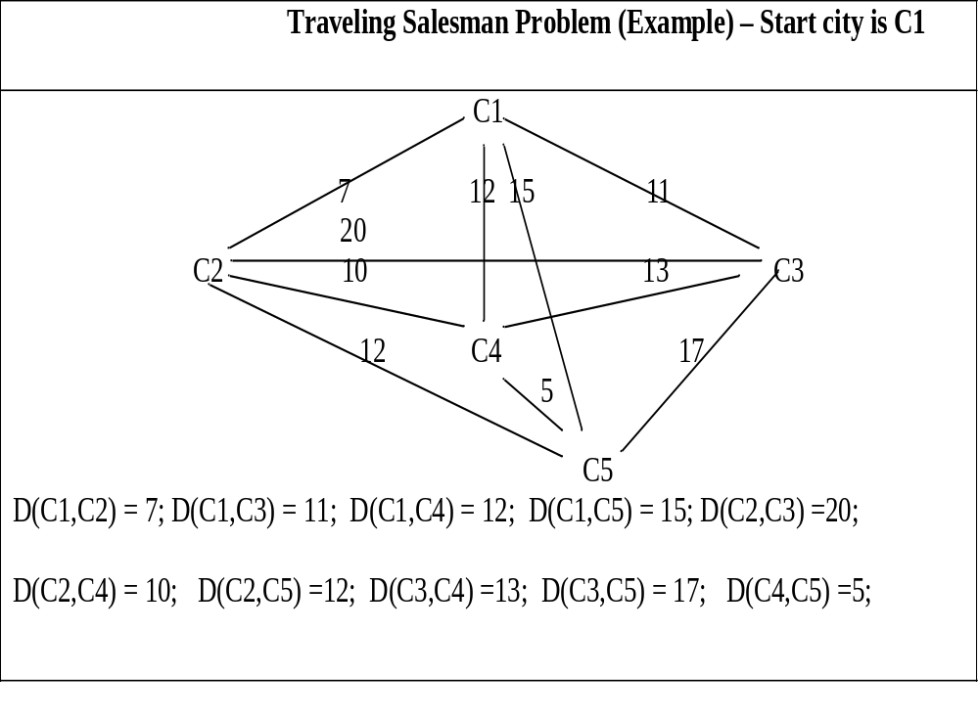
Prof Saroj Kaushik

Slide 31
Contd..
A simple motion causing and systematic control structure could, in principle solve this problem.
Explore the search tree of all possible paths and return the shortest path.
This will require 4! paths to be examined.
If number of cities grow, say 25 cities, then the time required to wait a salesman to get the information about the shortest path is of 0(24!) which is not a practical situation.
Prof Saroj Kaushik

Slide 32
Contd..
This phenomenon is called combinatorial explosion.
We can improve the above strategy as follows:
  Begin generating complete paths, keeping track of the shortest path found so far.
  Give up exploring any path as soon as its partial length becomes greater than the shortest path found so far.
  This algorithm is efficient than the first one, still requires exponential time ∝ some number raised to N (number of cities).
Prof Saroj Kaushik

Slide 33
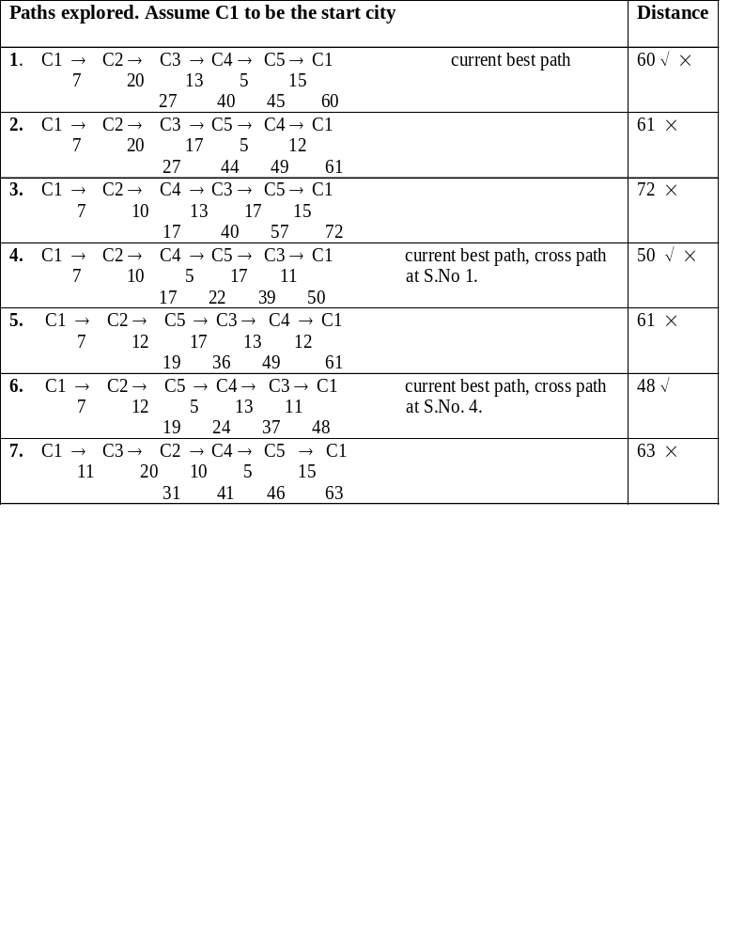
Prof Saroj Kaushik

Slide 34
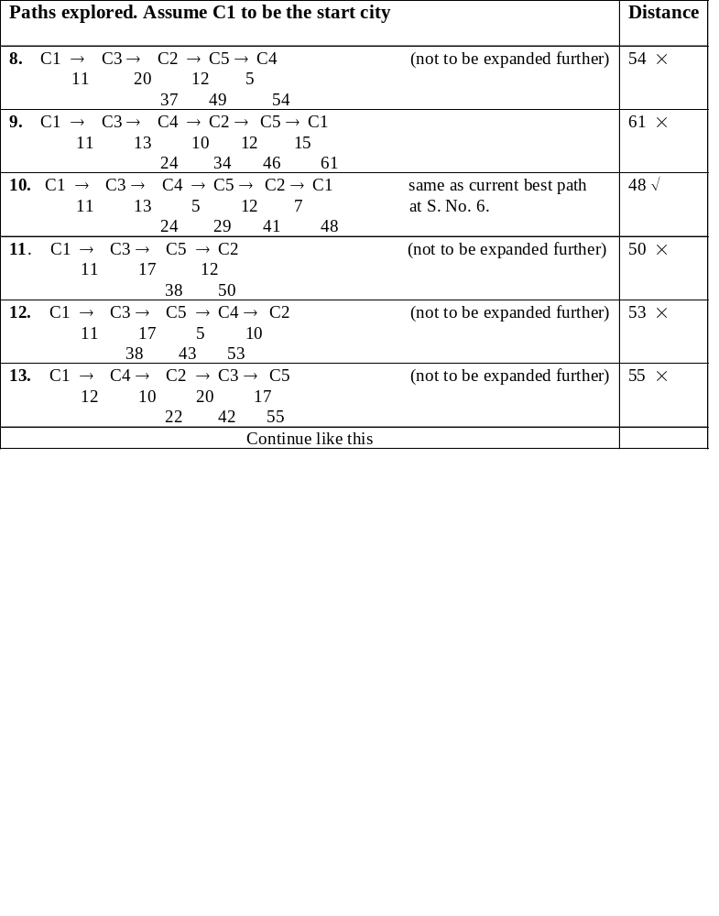
Prof Saroj Kaushik

Slide 35
Missionaries and Cannibals
Problem Statement: Three missionaries and three cannibals want to cross a river. There is a boat on their side of the river that can be used by either one or two persons.
Constraint:
  At any point in time, cannibals should not be more than missionaries.
    If the cannibals ever outnumber the missionaries (on either bank) then the missionaries will be eaten.
Prof Saroj Kaushik

Slide 36
Contd…
PS for this problem can be described as the set of ordered pairs of left and right bank of the river as (L, R) where each bank is represented as a list [nM, mC, B]
  n is the number of missionaries M, m is the number of cannibals C, and B represents boat.
Start state: ( [3M, 3C, 1B], [0M, 0C, 0B] ),
  1B means that boat is present and 0B means it is not there on the bank of river.
Goal state: ( [0M, 0C, 0B], [3M, 3C, 1B] )
Prof Saroj Kaushik

Slide 37
Contd…
Any state: ([n₁M, m₁C, 1B], [n₂ M, m₂ C, 0B]) , with constraints/conditions as n₁ (≠0) ≥ m₁; n₂ (≠0) ≥ m₂; n₁ + n₂ = 3, m₁ + m₂ = 3
  By no means, this representation is unique.
  In fact one may have number of different representations for the same problem.
  The table on the next slide consists of production rules based on the chosen representation.
Prof Saroj Kaushik

Slide 38
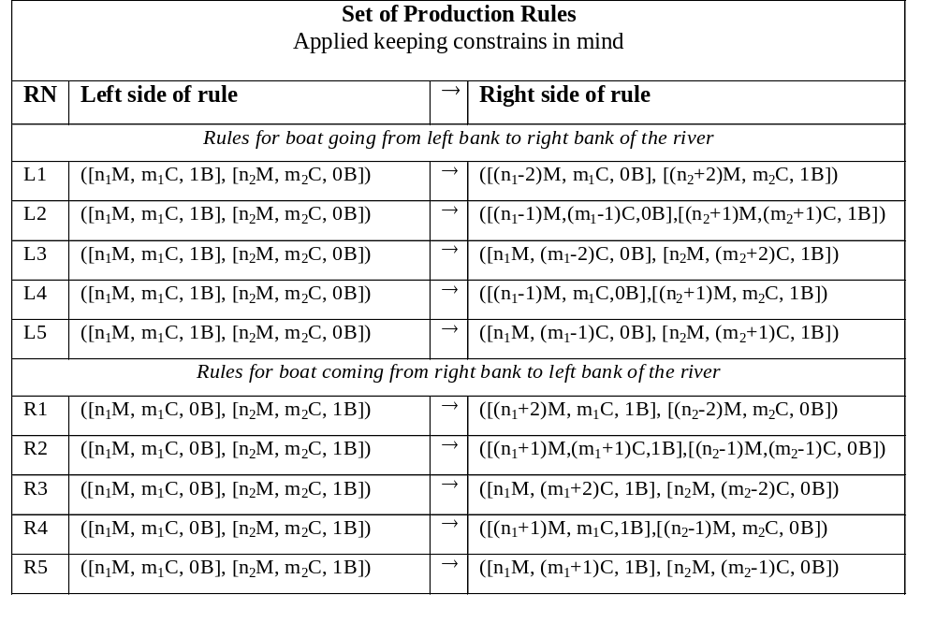
Prof Saroj Kaushik

Slide 39
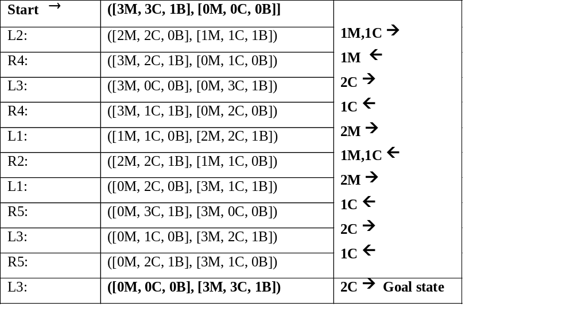
One of the possible paths
Prof Saroj Kaushik

